Slide 1
Participatory Governance, Participation and Civil Society International Forest Ecosystem Management (IFEM) Prof. Dr. Heike Walk

Slide 2
Sessions from 9am until 11.30am
Wednesday, 26 of March
Introduction to participatory governance and participation research
Theoretical concepts and practical approaches
Thursday, 27 of March
National Network for Civil Society (BBE) Programmtagung “Engagiert für Klimaschutz, Klimaschutz als zivilgesellschaftliche Aufgabe” Refugio Berlin, Lenaustr.3-4
Friday, 28 of March
Excursion to “Haus der Menschenrechte und Demokratie”
Independent Institute for Environmental Issues (UfU)
Environmental Action Germany (Deutsche Umwelthilfe)
© Jan-Paul Gauly, 2017
© Jan-Paul Gauly, 2017

Slide 3
Introduction round:
When you think of participation and civil society, what spontaneously comes to your mind?
What would you like to look at in more detail?
© Jan-Paul Gauly, 2017
© Jan-Paul Gauly, 2017

Slide 4
Very general level
steering control
the manner in which power is exercised (by governments, institutions, companies, NGOs,etc.)
© HNEE, Ulrich Wessollek, 2018

Slide 5
Governance in social science theory is …
the interaction between governments, business stakeholders and non-profit organizations by which policy decisions and implementations are undertaken
© HNEE, Ulrich Wessollek, 2018

Slide 6
The government…
shares the decision and implementation processes with other actors
transfers steering competencies to supra-national authorities, such as the United Nations or the European Union.
recognizes sub-national (local and regional) governments
shift of power upwards, downwards and sideways
© HNEE, Ulrich Wessollek, 2018

Slide 7
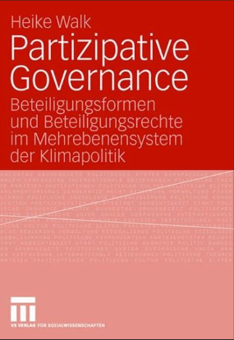
Various focal points in governance research
© HNEE, Ulrich Wessollek, 2018

Slide 8
What does participatory governance mean?
civil society and the democratic engagement of individuals and private groups is given a special significance
wants citizens and stakeholders to become an active part in decision making
deliver better policies, strengthen democracy and build trust
© Jan-Paul Gauly, 2017
© Jan-Paul Gauly, 2017
Sourcehttps://democracychronicles.org/wp-content/uploads/Untitled-1-175.jpg

Slide 9
What does participation mean?
people being involved in decisions that affect their lives
different intensity: ranges from information to collaboration and citizen control
opportunities and strategies for action and change
challenges oppression/ discrimination
recognised as a ‘right’
improve projects or programmes
© Jan-Paul Gauly, 2017
© Jan-Paul Gauly, 2017
Source: www.clipartpanda.com/categories/meet-with-teacher-clipart

Slide 10
Professional options:
you can either focus on research or carry out participation processes yourself
© Jan-Paul Gauly, 2017
© Jan-Paul Gauly, 2017

Slide 11
What is participatory research?
researchers act as facilitators
subjects of the research become involved as partners
projects vary in purpose, level of participation and representation
different levels of participation are possible
important to understand stake- holders involved and the power relations
© Jan-Paul Gauly, 2017
https://www.thebluediamondgallery.com/wooden-tile/r/research.html

Slide 12
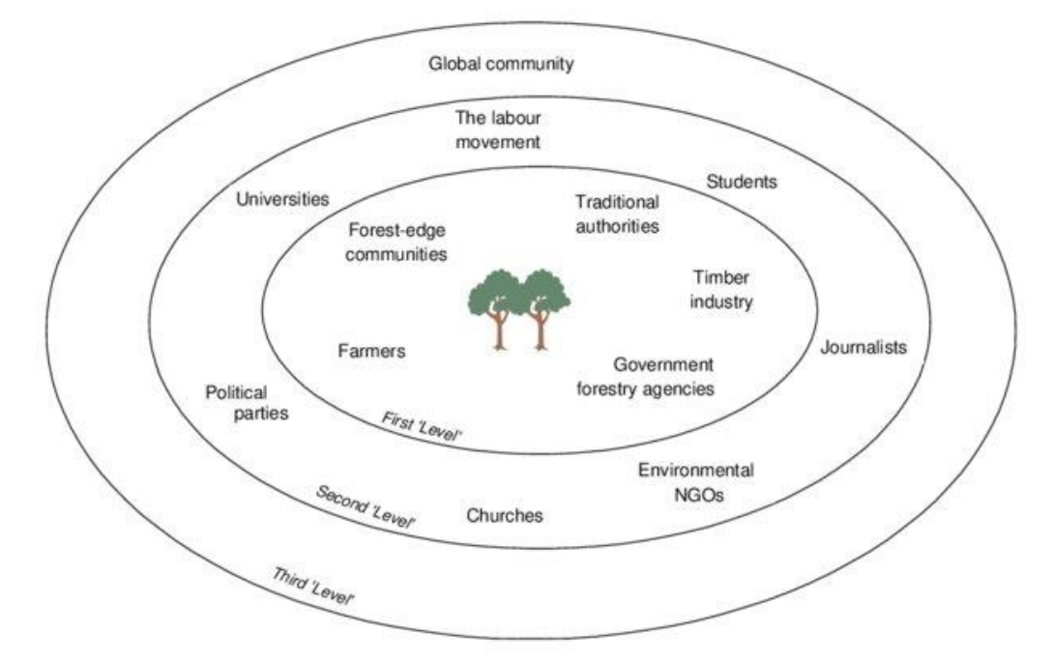
Stakeholder analysis can help you to…
identify stakeholders and their motivations
decide who should be involved in projects
manage expectations and engage stakeholders
use stakeholder advice and opinions to improve the project
find ways to increase stakeholder interest or support for the project
© Jan-Paul Gauly, 2017
Source: https://afforum.org/wp-content/uploads/2023/06/2023-
STAKEHOLDERS-AND-THEIR-ROLES-IN-FOREST-PLANNING.pdf

Slide 13
First step: identification of different actors at different levels
Governance Actors | Local/regional/national | International
State | Government, Parliament, Executive, Legislature, Judiciary, Parties | International institutions and organisations (e.g. United Nations Environmental Program (UNEP), International Labour Organization (ILO)
Non-State: Civil society | Associations, NGOs, foundations, social movement networks, Citizen initiatives | International nongovernmental organisations (INGOs), Transnational social movements
Non-State: Business sector | Companies | Multinational companies
© Jan-Paul Gauly, 2017
Source: own figure
© Jan-Paul Gauly, 2017

Slide 14
Work task: Stakeholder analysis
- Work groups: 3 people
- Look for an example of participation in forestry
Who was involved?
Can you identify different stakeholders?
© Jan-Paul Gauly, 2017
© Jan-Paul Gauly, 2017

Slide 15
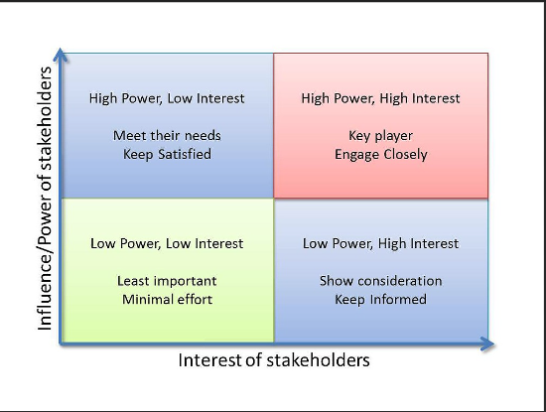
Second step: prioritize your stakeholders with a matrix
© Jan-Paul Gauly, 2017
https://www.showme.com/sh/?h=dOnZpIW

Slide 16
Work task: prioritize your stakeholders!
Can you identify the influence/ power and the interest of stakeholders?
Can you arrange them in the matrix?
© Jan-Paul Gauly, 2017
© Jan-Paul Gauly, 2017

Slide 17
Third step: analysis of the goals and purpose
the goal and purpose of participation can be very different
it is shaped by the initiators and their motivation
can be supported through a variety of formats
© Jan-Paul Gauly, 2017
© Jan-Paul Gauly, 2017

Slide 18
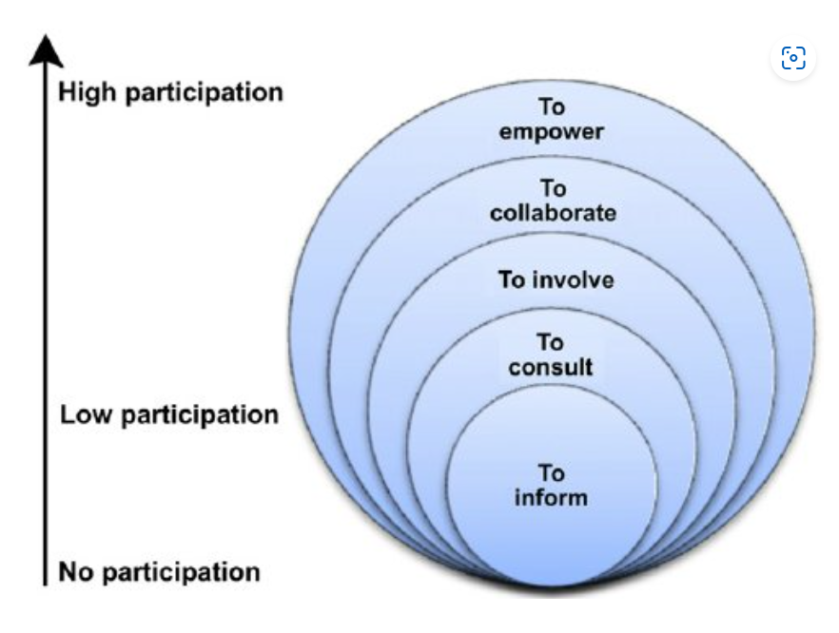
Goal and purpose of participation
© Jan-Paul Gauly, 2017
© Jan-Paul Gauly, 2017
Source: International Association for Public Participation, 2007

Slide 19
Work tasks:
Look at your example of participation in forestry.
What was the goal and purpose of participation (information, consultation, involvement, collaboration or empowerment?
© Jan-Paul Gauly, 2017
© Jan-Paul Gauly, 2017

Slide 20
Literature:
Bache, I. & Flinders, M., Eds., (2004). Multi-Level Governance, Oxford: Oxford University Press,
Baldwin, Elizabeth (2020). Why and How Does Participatory Governance Affect Policy Outcomes? Theory and Evidence from the Electric Sector. In: Journal of Public Administration Research and Theory, June 2020
Mbeche, R. / Ateka, J./ Herrmann, R./ Grote, U. (2021): Understanding forest users' participation in participatory forest management (PFM): Insights from Mt. Elgon forest ecosystem, Kenya, in: Forest Policy and Economics, Volume 129, August 2021, 102507
Paletto, A. (Ed.) (2019): Participatory Forestry: Involvement, Information and Science, Basel: MDPI, https://doi.org/10.3390/books978-3-03921-332-0
Rosenau, J. N. & Czempiel, E.O., Eds. (1992). Governance without Government: Order and Change in World Politics. Cambridge: Cambridge University Press
© Jan-Paul Gauly, 2017
© Jan-Paul Gauly, 2017

Slide 21
Literature:
Umweltbundesamt (2020): Bundesrepublik 3.0 A contribution to the development and strengthening of parliamentary-representative democracy through greater participation at federal level, Text 57/2020, Link: https://www.umweltbundesamt.de/sites/default/files/medien/1410/publikationen/2020-05-06_texte_57-2020_bundesrepublik_3.0_en.pdf
Walk, H./ Ott, H.O./ Welp, M. (2019): Everyone affected and involved: civil society systems. In: Ibisch, P. L./ Molitor, H./ Conrad, A./ Walk, H./ Mihotovic, V./ Geyer, J. (eds.). Humans in the Global Ecosystem, München: oekom, p. 241-259
Walk, H. (2008): Partizipative Governance. Beteiligungsrechte und Beteiligungsformen im Mehrebenensystem der Klimapolitik, Wiesbaden: VS Verlag für Sozialwissenschaften
© Jan-Paul Gauly, 2017
© Jan-Paul Gauly, 2017

